Slide 1
Neutralization assays of WT Perth/2009 HA GFP viruses with polyclonal serum
Rachel Eguia
January 7th, 2019- February 19th, 2019

Slide 2
Serum inactivation
In order to use serum for neutralization assays and for library selection experiments, I first need to prepare the serum by inactivating it. I will do this by first treating the serum with receptor destroying enzyme (RDE) to cleave any sialic acids in the serum which may prevent binding of HA to cells and ultimately viral entry. After treating the serum with RDE, I will heat-inactivate the serum to inactivate the RDE and inactivate non-specific inhibitors, namely complement.
I am following the protocol from Seth Zost (Scott Hensley lab), copied on the next slide.
Juhye bought a box of 5 bottles of RDE II, manufactured by Seiken Japan, identical to the RDE Seth uses.
07Jan19
Preparing RDE:
(note Juhye does not resuspend the RDE powder in physiological saline. Use PBS instead)
Filtered 20 mL of PBS through a 0.20 micron filter into a 50-mL conical.
Carefully removed the rubber stopper from the glass vial, and added 2 mL of the filtered PBS to the vial. Closed the vial with the stopper, and inverted to mix a couple of times to remove RDE powder from the inside of the rubber stopper.
Added the remaining 18 mL of PBS to the vial.
Inverted to mix. Made 400 uL aliquots of RDE in labeled eppendorf tubes, and froze down aliquots at -20°C.
08Jan19
Inactivating serum samples from Emergent Biosolutions:
Thaw serum samples and RDE tubes on ice (20 samples (see table at right), 16 RDE tubes)
Note: serum samples took approx. 1.5 hrs to thaw (on ice with occasional warming with hands)
Mixed 100 uL serum with 300 uL RDE solution in labeled eppendorf tubes. Mixed by pipetting, then flicked tube to mix.
Placed tubes in 37°C water bath in the TC room for 2.5 hours. Time: 11:45 AM
Transferred tubes to 55°C heat block with diH2O in the tube slots. Taped the tubes down. Incubated the serum for 30 min. Time: 2:20 PM
Spun down tubes in microcentrifuge at max speed (14,000 rpm) for >25 min. Time: 2:50 PM
If precipitant formed in bottom of tube, transferred supernatant to newly labelled epi
Froze samples at -80°C Time: 3:30 PM
ID | Bleed # | Donor # | Bleed Date | Age
1 | SX0017832 | 1551 | 11/25/08 | age 22
2 | SX0018970 | 1551 | 1/15/09 | age 22
3 | WF0276952 | 13585 | 9/30/08 | age 22
4 | WF0278756 | 13585 | 10/23/08 | age 22
5 | SX0014842 | 1379 | 7/23/08 | age 25
6 | SX0018884 | 1379 | 1/12/09 | age 25
7 | JB0223740 | 00954 | 12/24/08 | age 26
8 | JB0224952 | 00954 | 1/5/09 | age 26
9 | WF0294294 | 01390 | 4/22/09 | age 28
10 | WF0296536 | 01390 | 5/15/09 | age 28
11 | JB0224165 | 00238 | 12/29/08 | age 29
12 | JB0224828 | 00238 | 1/5/09 | age 29
13 | JB0223345 | 03923 | 12/20/08 | age 42
14 | JB0224978 | 03923 | 1/5/09 | age 42
15 | JB0224433 | 01925 | 12/31/08 | age 48
16 | JB0224533 | 01925 | 1/2/09 | age 48
17 | JB0222697 | 04990 | 12/15/08 | age 55
18 | JB0224840 | 04990 | 1/5/09 | age 55
19 | TT0164254 | 04609 | 3/31/09 | age 59
20 | TT0167529 | 04609 | 4/23/09 | age 59

Slide 3
Preparation for SEIKEN “Japan” RDE
Add 18 ml filtered DI water to the RDE bottle.
Invert until mixed.
Add 2 ml 8.5% NaCl (10x) to bottle.
Invert until mixed.
Use immediately or aliquot and freeze in the -20.
RDE treatment of samples:
Turn on waterbaths to preheat.
Mix 1 part serum to 3 parts RDE (example: 6ul serum + 18ul RDE). Times wanted volume by 3.
Flick tube to mix.
Put in 37°C bath for 2 hours.
Move tube to 55°C bath for 30 min.
Refrigerate samples.
Product: RDE II
Supplier: Accurate Chemical
Catalog number: YCC340-122

Slide 4
09Jan19
Make Neutralization Assay Media (NAM)
Prepared NAM by combining the following reagents and filtering it through a steritop with a 0.22 um filter:
20 mL 7.5% BSA
5 mL Pen-Strep
500 uL calcium chloride
50 uL heat-inactivated FBS
12.5 mL HEPES
462.5 mL Medium99
10Jan19
Neutralization assays against WT Perth/2009 + WSN NA GFP virus with polyclonal serum
I will set up neutralization assays for the polyclonal sera I RDE-treated and heat-inactivated on 08Jan19
I will make 12 serial dilutions of antibody in triplicate in a 96-well plate, and test neutralization against WT Perth/2009 + WSN NA GFP virus that Juhye rescued.
First I will make 1:3 dilutions of all the serum samples since I am concerned that undiluted serum can kill cells. To do this I will dilute 50 uL of serum in 100 uL NAM for 150 uL total volume. I will use this diluted serum for the top row of the serial serum dilutions.
I will then serially dilute the serum 3-fold by transferring 40 uL across wells.
Serum samples:
SX0018970/2009 human (Emergent Biosolutions)
WF0296536/2009 human (Emergent Biosolutions)
TT0167529/ 2009 human (Emergent Biosolutions)
4C01 (positive control)
 | Serum
Row | 3-fold dil.
1 | 1/9 (0.074)
2 | 1/27 (0.0247)
3 | 1/81 (0.00822)
4 | 1/243 (0.00274)
5 | 1/729 (0.000914)
6 | 1/2187 (0.0003045)
7 | 1/6561 (0.0001015)
8 | 1/19683 (0.0000338)
9 | 1/59059 (0.0000113)
10 | 1/177147 (0.00000376)
11 | 1/531441 (0.00000125)
12 | 1/1594323 (0.00000042)

Slide 5
10Jan19 Neutralization assays against WT Perth/2009 + WSN NA GFP virus with polyclonal serum
“A-H” will be referred to as columns, and “1-12” as rows. I had the plate with column A-H going left to right, and rows 12-1 from top to bottom.
I used the “Perth/2009 HA + WSN NA GFP virus” that Juhye rescued on 20180905. Based on the MOI test Juhye conducted, I will use an MOI of 0.5 for these neutralization assays.
For multichannel, used Fisher brand blue box/green wafer tips, #02-707-431
Thawed sera and made dilutions to working stock solutions using NAM
Samples: Diluted 50 uL of serum in 100 ul NAM for 150 uL total volume. Added 40 uL of diluted serum to the top row of the serial serum dilution columns (D/E/F) for each serum sample
Positive control antibody: Made a ”working dilution” of 4C01 antibody.
Added 80 uL NAM to all wells of all 4 plates (~35 mL of NAM). Also began thawing viruses
Added 40 uL of the diluted serum to the top row (row 12) of the plate for columns D, E, and F. Did this for each plate
Using the multichannel with three tips attached, mixed the top row D/E/F and transferred 40 uL the second row, mixed, etc. Removed 40 uL from the last row. Did not change tips in between rows (not necessary here)
Added 40 uL NAM to column B of all plates (virus only column) to make up for no cells being added to these columns.
Prepared virus inoculum. Diluted Perth/09 HA + WSN NA GFP 48 hpt virus to 500 IP/ul. (~3.5 mL per plate= 14 mL total)
Titer = 2419 IP/uL. Make MM of virus (2.89 mL virus + 11.11 mL NAM)— need 3 aliquots of virus
Using a reservoir and multichannel with six tips attached, added 40 uL of virus to columns B-G. Used new tips for each row, but did not mix virus and Ab (no need to mix). Wrote down time once virus was added to all wells of a plate, and incubated at 37°C.
While virus + antibody mixtures were incubating, started preparing cells by trypsinizing MDCK-SIAT1-PB1-TMPRSS2 cells, neutralizing with D10, spinning at 1200 rpm for 4 min, then resuspending in 20 mL NAM
Made a master mix of cells at 1e6 cells/mL, making a 14 mL master mix (~3.5 mL per plate)
Counted ~1e6 cells/mL => no need to dilute, just used 14 mL of this
After ~1.5 hr of virus + Ab incubation, took each plate out of the incubator in order, and added 40 uL cells to columns C-G, using fresh tips for each row. Used a fresh reservoir for each plate, re-mixed cell suspension before adding to reservoir. Wrote down time cells were added to the wells of a plate
At ~17 hpi ( 8:50 AM), read on plate reader with “Neutralization assay 96 well” program.
 | COLUMN
ROW | A | B | C | D | E | F | G | H
1 | NAM only | virus only | virus + cells only | serum dilution | serum dilution | serum dilution | virus + cells only | NAM only
Antibody | Vol of Ab for serial dil | Time start virus + Ab | Time start virus+Ab+cells
#2 SX0018970/2009 human | 40 ul (3-fold dilutions) | 2:15 | 3:37
#10 WF0296536/2009 human | 40 ul (3-fold dilutions) | 2:19 | 3:43
#20 TT0167529/ 2009 human | 40 ul (3-fold dilutions) | 2:23 | 3:49
4C01 (positive control) | 40 ul (3-fold dilutions) | 2:09 | 3:29

Slide 6
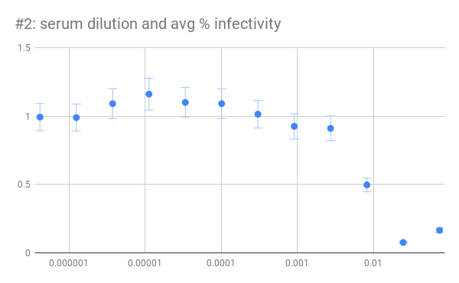
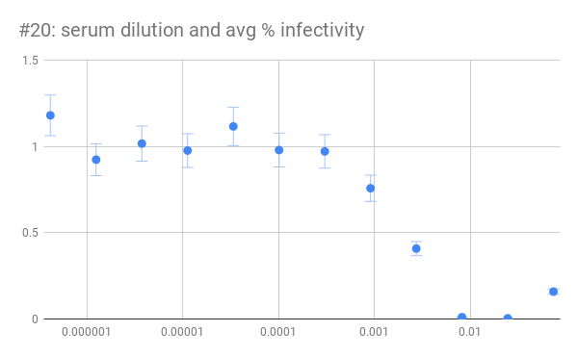
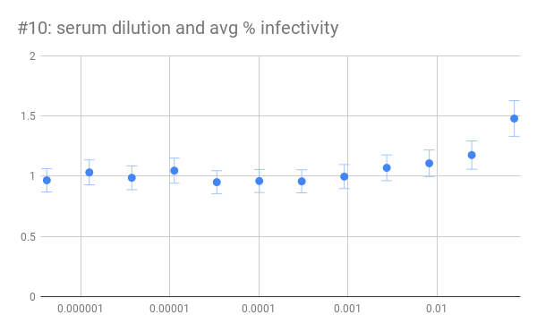
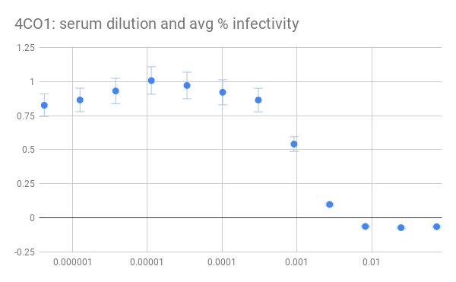
11Jan19 Results of neutralization assays with polyclonal serum samples

Slide 7
Making more WT Perth/2009 + WSN NA GFP virus
09Jan19
Thawing 293T-CMV-PB1 cells
Thawed 1 vial of 293T-CMV-PB1 cells in 37°C water bath
Added entire solution from vial to ~9.5 mL of D10 media in a 10 cm dish
Placed in 37°C incubator.
Will change media (to get rid of the DMSO in the freezing solution) tomorrow morning
Prepping WSN and Perth HA pHW plasmids for growing virus
Plasmids: 30, 31, 32, 34, 35, 36, 37, 208, 1422, 1561
Streak plates from glycerol stocks
Warmed 5 LB/Amp plates (10 samples= 2 plasmids per plate) for about 30 min
Used plastic streaking tool to streak out each sample onto their labelled quadrants
Placed in 37°C incubator.
10Jan19
Pick colonies and inoculate overnight cultures for plasmid minipreps
Inoculate 3.5 mL LB/Amp cultures
Grow overnight in 37°C shaking incubator
11Jan19
Purified plasmids using Qiagen miniprep kit (Juhye did this)
Used overnight cultures from 10Jan19
Spun down cultures at 4,000 rpm for 20-25 minutes in cold room centrifuge
Eluted with 50 uL EB
Measured concentration and purity using Nanodrop

Slide 8
Making more WT Perth/2009 + WSN NA GFP virus
14Jan19
Seeded a coculture of 293T-CMV-PB1:MDCK-SIAT1-CMV-PB1-TMPRSS2 cells
Seeded 4 x 10⁵ 293T-CMV-PB1 cells and 0.5 x 10⁵ MDCK-SIAT1-PB1-TMPRSS2 cells per well, 2 ml per well, into six 6-well plates
Made a 75 ml master mix of cells
Added 2 ml of the master mix of cells to its corresponding well. Incubated at 37°C
Plated at 3:30 PM
Cell Dilution Calculation
Target cell concentration = 1500e4 293T cells and 187.5e4 MDCK cells
1,500e4 cells / 706 e4 cells/mL = 2.125 mL of cell culture
187.5e4 cells / 230 e4 cells/mL = 0.815 mL of cell culture
75 mL — 2.125 mL of 293T cell culture — 0.815 mL of MDCK cell culture = 72.06 mL of D10
Made a master mix of WSN internals + TMPRSS2 plasmid (1422) + pHH-PB1flank-eGFP plasmid (208):
15Jan19
Transfections: transfected cocultures seeded yesterday with influenza reverse genetics plasmids to rescue. Used 14Jan19 Transfection Calculations for Making Virus spreadsheet to calculate volumes
Checked cocultures ~17 h after seeding – seemed to be pretty confluent with a few cells floating around in each well
Added 6.30 uL of the master mix above to an eppendorf tube. This will be the no HA control
To the remaining 37X master mix, added 38.16 uL of plasmid #1561 (pHW-Perth2009-HA-G78D-T212I, concentration = 242.4 ng/uL). Mixed.
Added 7.33 uL of the internals + HA master mix to 34 wells in a 96-well plate.
Made DMEM + BioT master mix: 4000 uL DMEM + 120 uL BioT
Added 103 uL of the DMEM + BioT master mix to each transfection well (and no HA control tube) and mixed by pipetting up and down. Incubated at RT for ~20 min. Added the plasmid-DMEM-BioT mix dropwise to its corresponding well. Mixed by tilting the plate
Incubated the plates at 37°C (Start: 9 AM)
Changed media of transfected cells to IGM (5 PM)
Aspirated D10 and gently added 2 mL IGM with P1000 pipet
Be sure to use Wescodyne at this stage (presumably some fully formed virus at this time)
Plasmid | Segment | Conc (ng/uL) | Vol for 38X GFP MM (uL)
30 | WSN PB2 | 507.5 | 18.72
32 | WSN PA | 576.2 | 16.49
34 | WSN NP | 198.5 | 47.86
35 | WSN NA | 370.8 | 25.62
36 | WSN M | 210.6 | 45.11
37 | WSN NS | 305.5 | 31.10
1422 | TMPRSS2 | 354.0 | 26.84
208 | PB1flankGFP | 343.2 | 27.68
 |  | total uL | 239.41

Slide 9
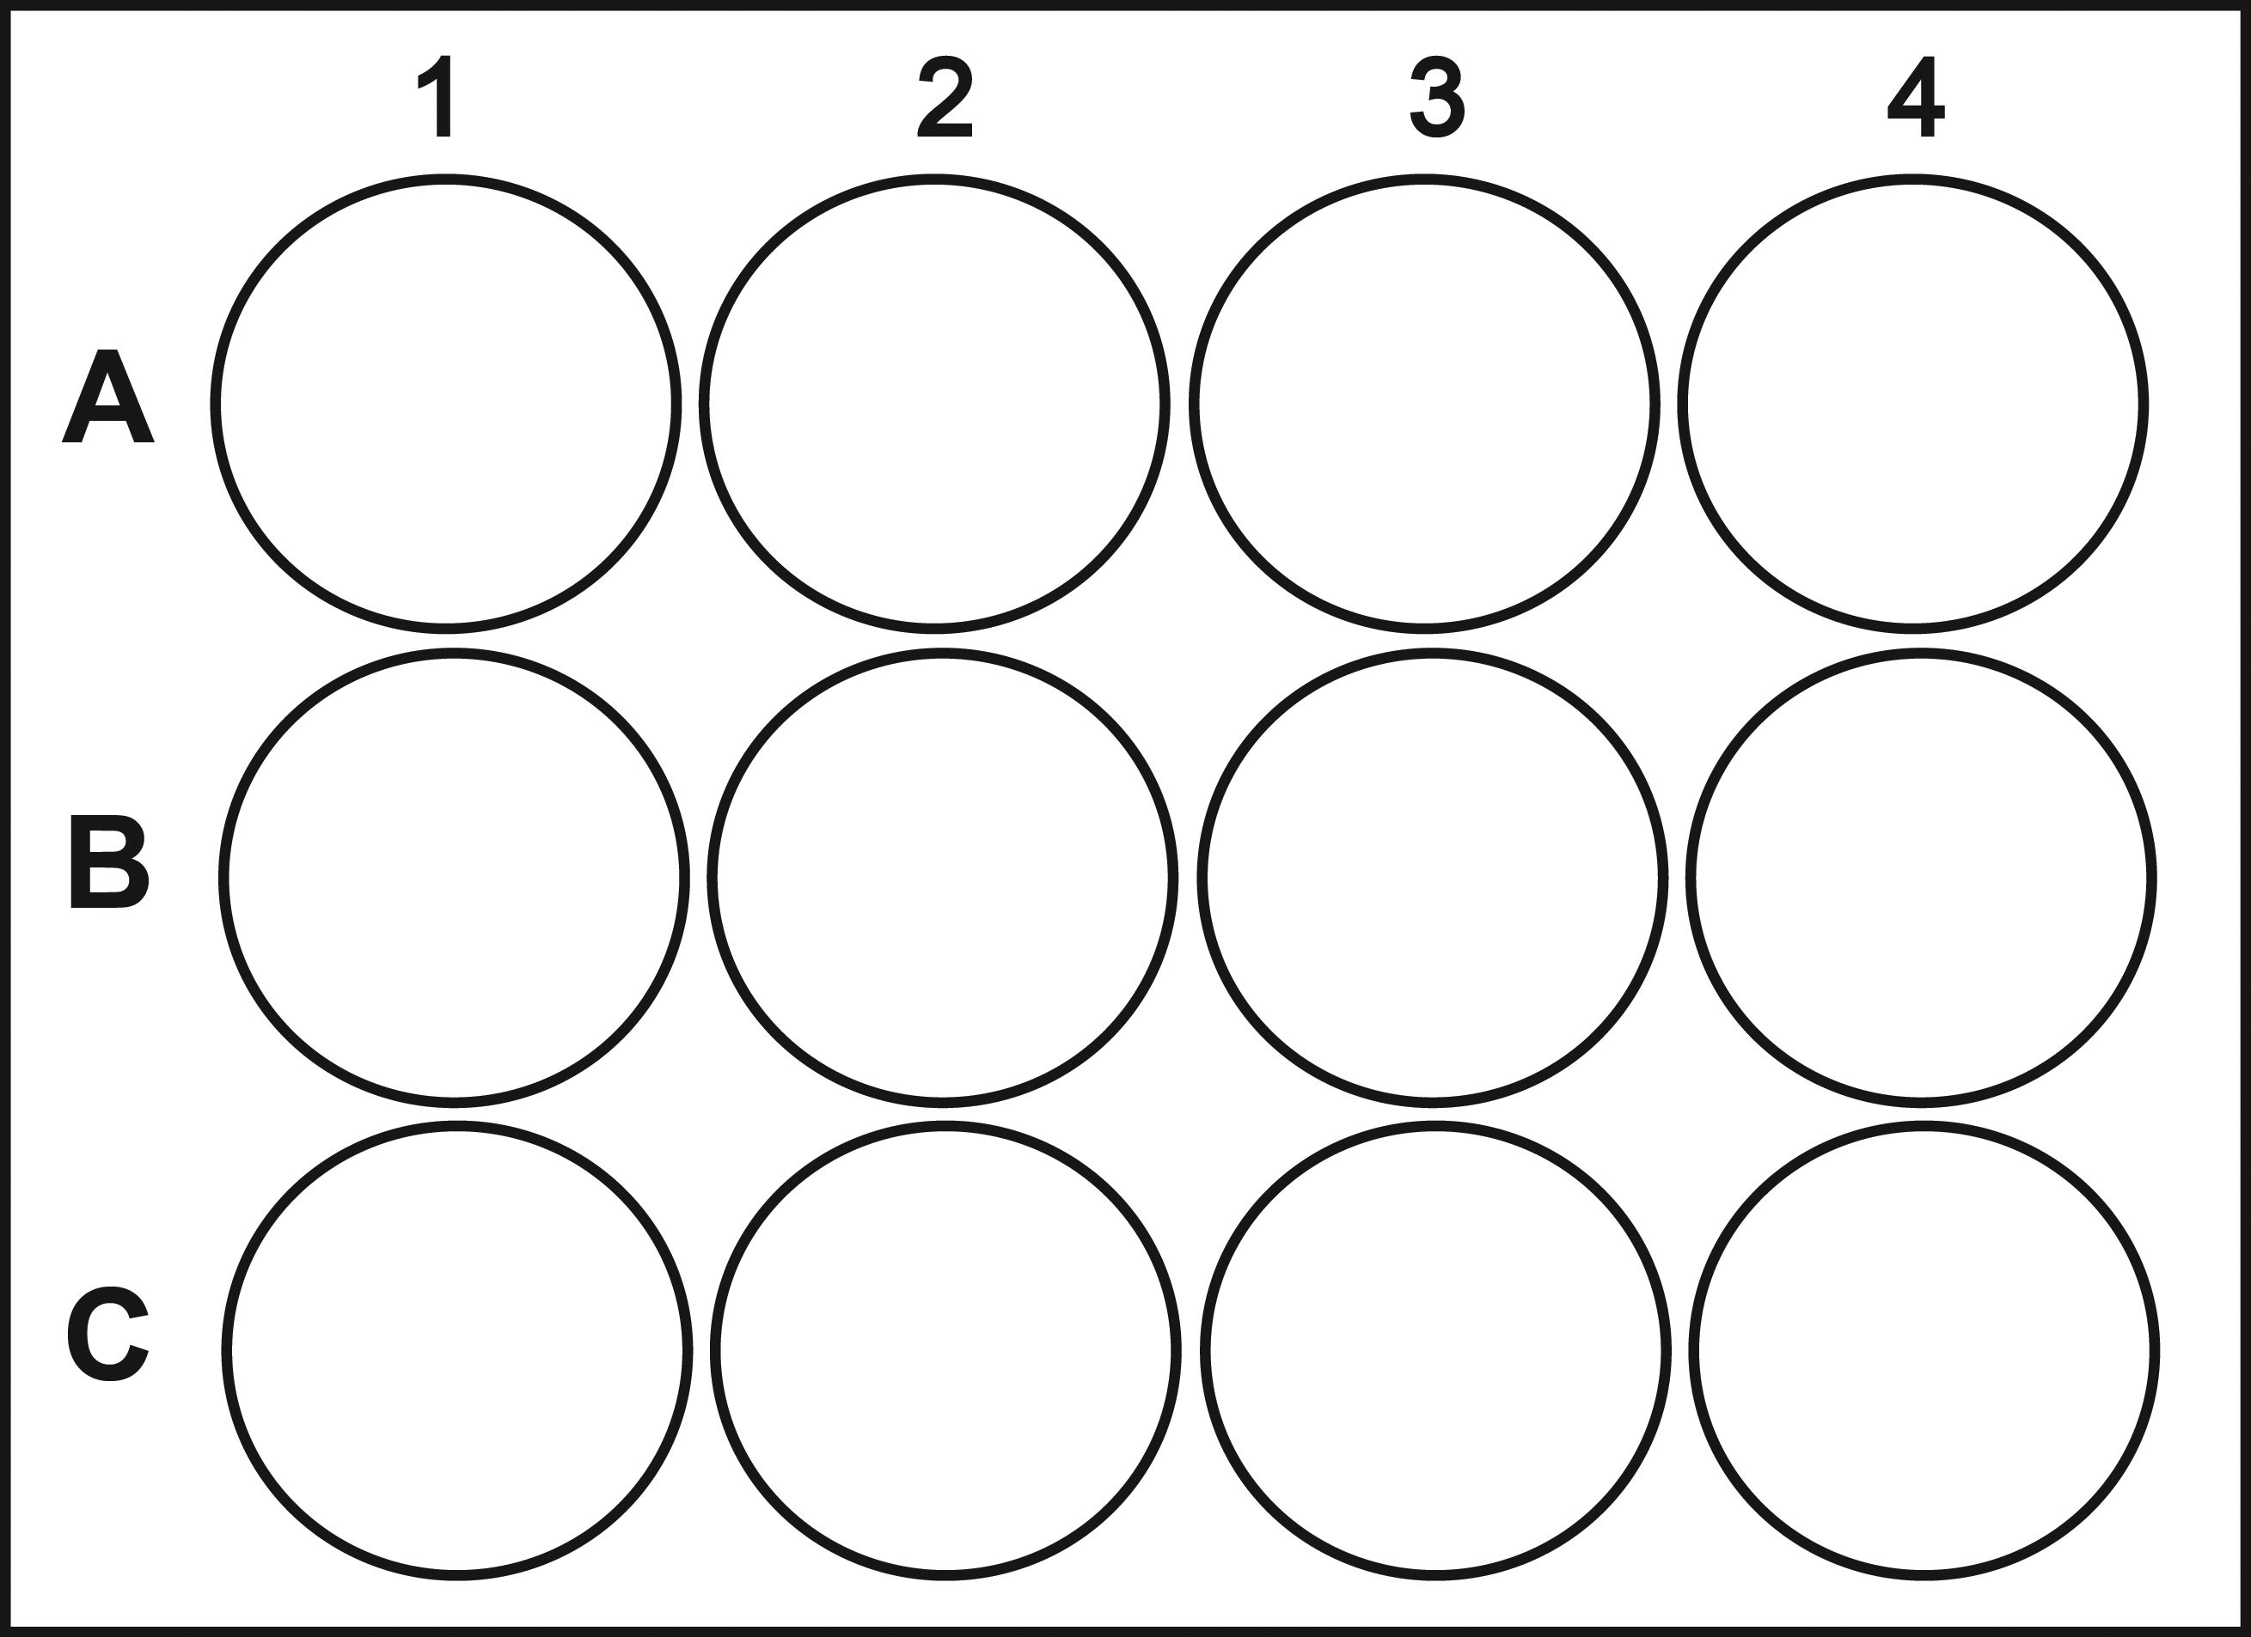
17Jan19
Harvested viral transfection supernatant
3 PM: I saw all 293T’s green, and faint spread of green to neighboring MDCK cells. Saw no spread of green to MDCK’s for no HA control and no green in the BioT control well. Juhye decided to collect later (around 7 PM) to get higher titer virus
7 PM: Juhye checked plates again and decided to let the transfection go until the morning.
18Jan19
8 AM:
Collected transfection supernatant at 54 hpt 58hpt 71 hpt.
Collected transfection supernatant in two 50 mL tubes and spun at 2,000 x g for 5 min to clarify supernatant (e.g. spin down dead cells)
Collected 61 x 1 mL aliquots of the P09 HA + WSN NA viruses and 2 x 800 uL aliquots of the no HA ctrl. Froze down aliquots at -80°C
Note: cryovial labels say “54 hpt”, but virus was actually collected at 71 hpt (didn’t want to relabel all of the tubes)
Titering WT Perth/2009 + WSN NA GFP virus
12Feb19: Thawed MDCK-SIAT1-PB1- TMPRSS2 cells
Thawed a single cryovial of MDCK-SIAT1-PB1-TMPRSS2 cells in 37°C water bath for approximately 3 min. Pipetted 1 mL of cell media from cryovial into 9 mL of D10 media in a 10 cm dish. Changed media at end of day to get rid of the DMSO from the cell freezing media.
14Feb19: Seeded MDCK cells in 12-well plates (12:20 PM)
Split a plate of MDCK-SIAT1-PB1-TMPRSS2 cells. Resuspended pellet in 15 mL IGM
Made a master mix of each of these cells, at a density of 1e5 cells/mL. Made a 14 mL master mix in IGM of cells
Counted 8.91e5 PB1-TMPRSS2 cells => added 1.7 mL cells to 12.3 mL of IGM to make cell master mix with concentration of 1e5 cells/mL
Added 1 mL of cells to all wells of a 12-well plate
Incubated cells at 37°C to allow them to adhere
Infected MDCK cells with WT Perth/2009 + WSN NA GFP virus (from 17Jan19)
Checked 12-well plates to see that cells were adherent. Thawed virus supernatant (3:00 PM)
Made virus dilutions in a 96-well plate (3:30 PM)
Added 180 uL IGM to rows B/C/D/E of columns 2-3
Added 100 uL of undiluted virus supernatant to row A of its corresponding column
Transferred 20 uL to each row to make serial 10-fold dilutions
Infected cells with 100 uL of virus dilutions in rows B/C/D to achieve effective volumes of 10, 1, and 0.1, respectively (3:50 PM)
Added dilutions column-wise to the 12-well plate
A | Perth/09 HA + WSN NA, 71 hpt
B | No HA + WSN NA, 71 hpt
C | No virus
100 ul sup’t
10 ul sup’t
1 ul sup’t
0.1 ul sup’t

Slide 10
15Feb19: Prep MDCKs for flow (10 AM on LSR)
~17 hpi (9 AM), checked plates and picked wells that by eye looked like there were between ~1-10% green cells. Prepped cells for flow:
Aspirate the supes from all of the wells and decontaminate the pipet (and all tubes/tips/etc. from this point forward) with Wescodyne.
Add 350 uL trypsin to the wells you want to collect.
Collect the cells with 750 uL D10 into 1.5ml microfuge tubes.
Pellet cells at 1200rpm for 3 mins.
During the spin prepare 1% PFA (paraformaldehyde) in PBS from the 4% stock from Alistair.
After pelleting, aspirate the D10 and add 400uL of the 1% PFA in PBS. Wait 10-15 minutes to inactivate any virus.
Pellet cells at 1200rpm for 3 mins.
Wash cells with 500 uL PBS. Spin down again
Resuspend the cells with 500 uL of 1% BSA in PBS well then filter into FACS tubes using the 0.7um nylon filters.
Keep on ice until flow appointment at 10 AM on LSR.
P09 GFP: 10, 1, and 0.1 uL
No HA GFP: 10 uL
2 cell only samples
100 ul sup’t
10 ul sup’t
1 ul sup’t
0.1 ul sup’t
Results:
GFP virus titer looks good and is comparable to the titers that Juhye got from her batch of GFP virus (2419 IP/uL)
Sample | GFP positive percent | GFP positive fraction | number cells | uL used | IP/uL
P09 HA + WSN NA GFP | 3.16 | 0.0316 | 100000 | 1 | 3211.005392
no HA GFP | 0 | 0 | 100000 | 10 | 0

Slide 11
18Feb19: Perform MOI test
I will set up an MOI test to find the appropriate MOI for future neutralization assays. I will make two-fold serial dilutions of virus to test an MOI of 2 to 0.015625
Plate setup: (doing 2 replicates of the Perth/2009 HA + WSN NA GFP virus)
IP/well | MOI | Row
80000 | 2 | A
40000 | 1 | B
20000 | 0.5 | C
10000 | 0.25 | D
5000 | 0.125 | E
2500 | 0.0625 | F
1250 | 0.03125 | G
625 | 0.015625 | H
1 | 2 | 3 | 4 | 5 | 6 | 7 | 8 | 9 | 10 | 11 | 12
empty | virus + cells | empty | virus + cells | virus only | cells only | empty | virus only | empty
Sample | IP/uL | Target IP/uL | Target vol (uL) | vol virus (uL) | vol NAM (uL)
P09 HA + WSN NA GFP | 3211.005392 | 2000 | 500 | 311 | 189
Protocol:
Added 80 uL NAM to all wells, and 160 uL NAM to empty wells
Added 160000 IP of GFP virus in row A of columns 2-5
Diluted virus to 2000 IP/ uL by adding the specified volumes of virus and NAM (in above table) to 1.5 mL epi, then added 80 uL of each to row A).
Made serial two-fold dilutions down rows by transferring 80 uL down to each row, removing 80 uL from the final row (changed tips between each row)
Incubated plate for ~1 hr while splitting MDCK-SIAT1-PB1-TMPRSS2 cells. Resuspended cells in NAM
Made a 5 mL master mix of cells at 5e5 cells/mL in NAM
Added 80 uL of cells to columns 2/4/6, and 80 uL NAM to columns 3/5
Incubated plate at 37°C (START: 4 PM)
Read plate on plate reader at 10 AM (~18 hpi)

Slide 12
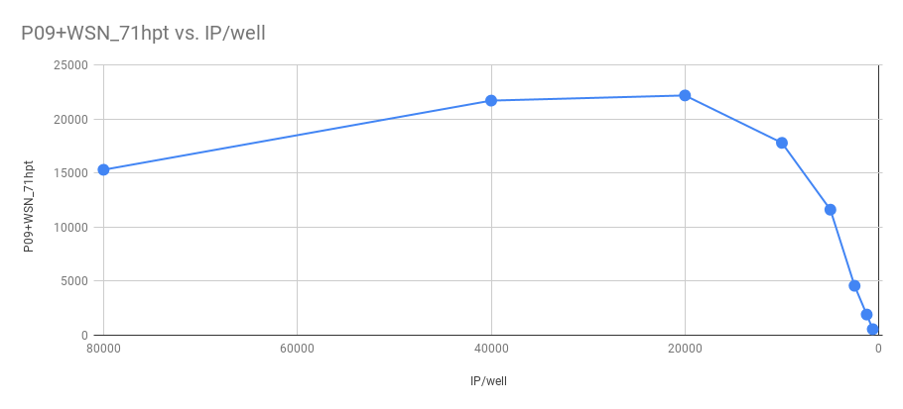
19Feb19: MOI test results
Based on the results, it seems like 10,000 IP/well is going to be the best infectious dose for neutralization assays with this virus. This translates to an MOI of 0.25.
<> | 2 | 3 | 4 | 5 | 6 | 7 | 8 | 9
A | 32924 | 39080 | 34618 | 18578 | 6229 | 6437 | 18318 | 6367
B | 33398 | 4967 | 33556 | 11625 | 5827 | 6256 | 11863 | 6107
C | 32149 | 4886 | 30185 | 8966 | 5843 | 6234 | 8948 | 6124
D | 25273 | 4819 | 25462 | 7588 | 5800 | 6024 | 7513 | 6058
E | 18716 | 4772 | 18213 | 6626 | 5712 | 6010 | 7054 | 5952
F | 10327 | 4668 | 11468 | 6187 | 5678 | 6050 | 6462 | 5987
G | 8293 | 4731 | 7930 | 6052 | 5641 | 6016 | 6355 | 5964
H | 6707 | 4751 | 6705 | 6103 | 5854 | 6146 | 6212 | 6049
 | virus + cells | empty | virus + cells | virus only | cells only | empty | virus only | empty
IP/well | MOI | signal-bkgd |  | avg |  | IP/well | P09+WSN_71hpt
80000 | 2 | 14606 | 16040 | 15323 |  | 625 | 548.5
40000 | 1 | 21535 | 21931 | 21733 |  | 1250 | 1908
20000 | 0.5 | 23201 | 21219 | 22210 |  | 2500 | 4573
10000 | 0.25 | 17760 | 17874 | 17817 |  | 5000 | 11624.5
5000 | 0.125 | 11662 | 11587 | 11624.5 |  | 10000 | 17817
2500 | 0.0625 | 3865 | 5281 | 4573 |  | 20000 | 22210
1250 | 0.03125 | 1938 | 1878 | 1908 |  | 40000 | 21733
625 | 0.015625 | 495 | 602 | 548.5 |  | 80000 | 15323

